Slide 1
Phase 1 Project
By Ainsley Nyambura

Slide 2
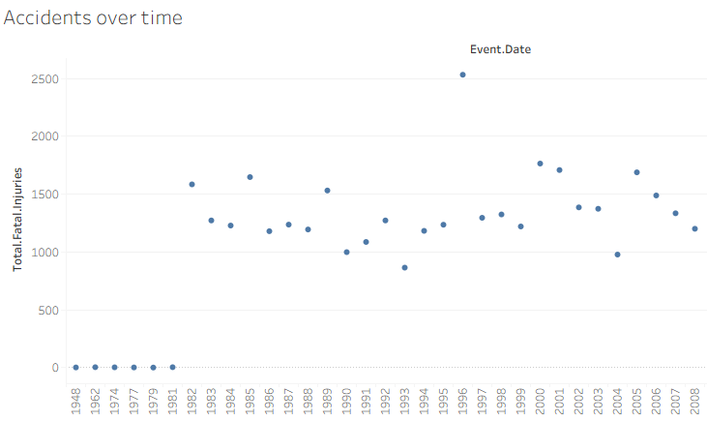
Accidents Over Time
The number of aviation accidents recorded per year. When the dots go up more airplanes had accidents and when they drop fewer accidents happened.

Slide 3
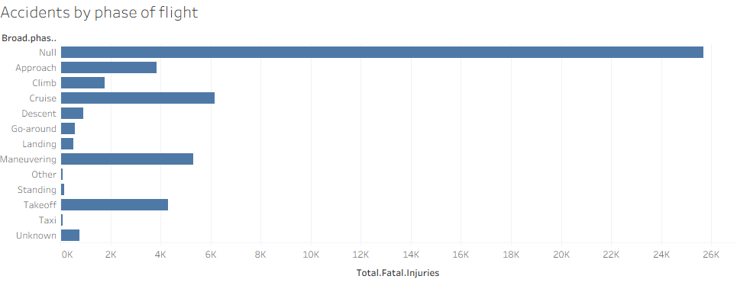
Accidents by Phase of Flight
The stage of flight when the accidents are most likely to happen. Flying has different phases this show which part is the most dangerous

Slide 4
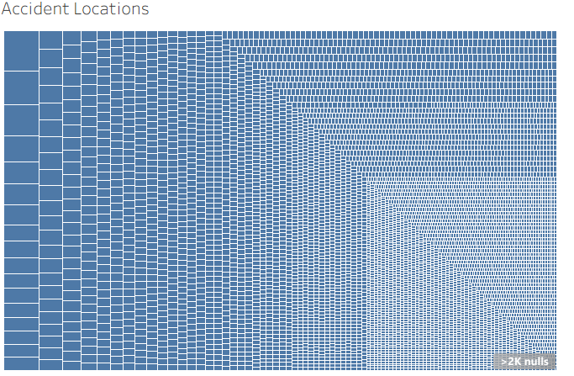
Accident locations(map)
The geographic locations where aviation accidents occur
Areas with bigger boxes have more accidents. These boxes show places where airplanes had trouble

